Slide 1
Automatic time table generating system
Using Genetic Algorithm

Slide 2
Solution in a nutshell
Developed a timetable scheduler using genetic algorithm
Inputs:-Courses, Rooms, Meeting Times, Departments ,Sections, Faculty.
Considers various scheduling constraints
Utilizes selection and crossover principles of genetic algorithms.
Generates near-optimal, error-free timetables.
Reduces processing power and time compared to manual scheduling.
Achieves 60%-80% of the optimal solution.
Provides a flexible, efficient, and paperless scheduling system.

Slide 3
Features
Automated scheduling
Conflict detection
Room assignment
Instructor scheduling
Flexible time slots
Department and course management
Customization
Efficient Use of Resources
Scalability
Course recommendation

Slide 4
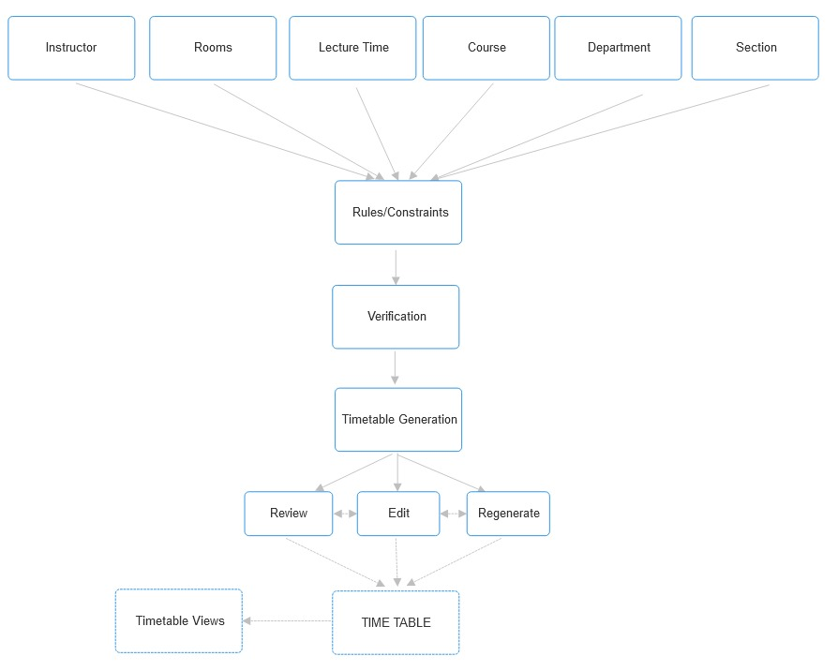
SYSTEM ARCHITECTURE

Slide 5
System design overview
Scheduling method based on Genetic Algorithm
Divided into several modules:
User-provided Data Integration
Initial Population
Evaluation of Population
Crossover Evolution
Mutation
New Population

Slide 6
USER-PROVIDED DATA INTEGRATION
The algorithm processes multiple inputs:
Rooms: Available lecture halls or classrooms.
Faculty: Professors or lecturers assigned to courses.
Courses: Subjects being scheduled.
Sections: Different student groups or batches.
Departments: Organizational units for courses and faculty.
These inputs are converted into a structured format (chromosomes) for the genetic algorithm to process.

Slide 7
INITIAL POPULATION
The initial population in timetable scheduling refers to creating multiple random timetable solutions
These solutions follow hard constraints like available rooms, courses, and lecturer schedules.
Generates timetables quickly but may not cover all possible solutions.
The population is a set of different timetable configurations from which the best ones evolve over time.

Slide 8
EVALUATION OF POPULATION
In timetable scheduling, evaluation of population measures how good each timetable is based on soft constraints (like avoiding back-to-back classes).
Each timetable receives a fitness score between 0 and 1, where 1 indicates a perfect timetable and 0 indicates a poor one.
The fitness function allows us to compare different timetables and identify the best solutions for further refinement.

Slide 9
Crossover Evolution and mutation
Crossover Evolution:
Creates new solutions based on existing ones.
Combines parts of two solutions to form new ones.
Helps generate fresh possibilities by mixing different elements.
Mutation:
Introduces random changes to a solution.
Helps explore new possibilities and improve results.
Only affects the solution being changed, without impacting others.

Slide 10
NEW POPULATION
This ongoing cycle helps the algorithm evolve and improve the timetables over time, aiming for better and more efficient scheduling solutions.

Slide 11
THANK YOU

